Slide 1
PartsTracker
Rudi Grobler

Slide 2
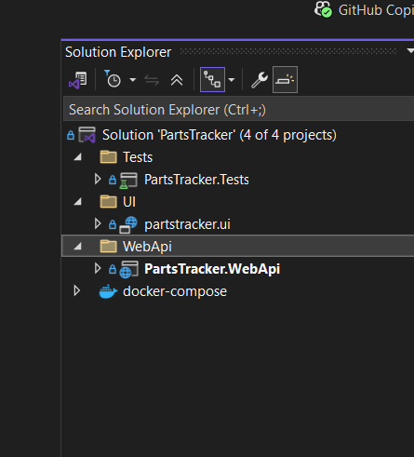
High Level Architecture
My solution is a very simple "microservices-inspired" architecture, with a .NET Web API backend, a separate UI, and infrastructure as code (IaC) managed via Terraform
UI
WebApi
DB

Slide 3
Cloud-native
The API is stateless, making it easy to scale horizontally in the cloud.
The use of Docker for containerization, enabling deployment to any cloud provider.
Infrastructure is defined as code, supporting repeatable, automated deployments.
API, UI, and infrastructure are decoupled, allowing independent development and scaling.

Slide 4
Constraints
To make this as easy as possible, currently theirs no authentication and all communication is via HTTP.
Please note this is only for development, and should NEVER be deployed like this!

Slide 5
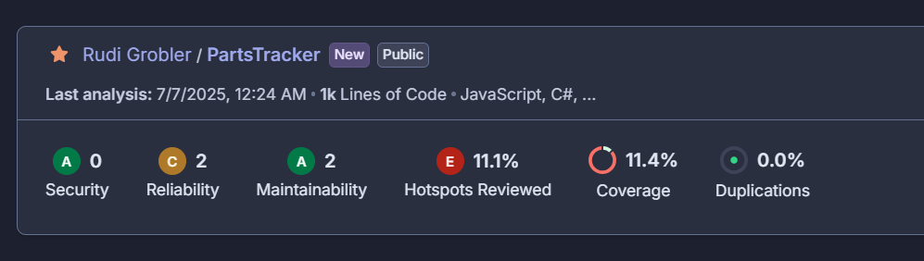
Code Quality
All code are checked via SonarCloud, triggered from a GitHub action to ensure we have no bugs, code smells and good coverage.
Although not “production ready”, the start of some CI/CD pipelines to automate testing and deployment, reducing risk of regressions.

Slide 6
Notes
Health checks implemented.
RESTful conventions used in controllers.
DbContext (EF) and a simple repository pattern is defined and used via Dependency Injection.
All end-points are well documented and exposed via OpenAPI.
Logging is actively used to help debug potential issues.
UI is a simple react app, using bootstrap
TODO: Client side validation

